Slide 1
Mind the Gaps-Part 5 Backwards Design
Miranda Manley

Slide 2
Session Purposes
Understand the Backward Design process.
Explore the process:
1. Identify the desired results.
2. Identify acceptable evidence of learning.
3. Design the instructional plan.
Plan for the next unit of study in your grade level & subject.

Slide 3
What is the backward design process?
Backward Design is a method of designing an educational curriculum by setting goals before choosing instructional methods and forms of assessment.
https://www.youtube.com/watch?v=mLKHaNo98Ts

Slide 4
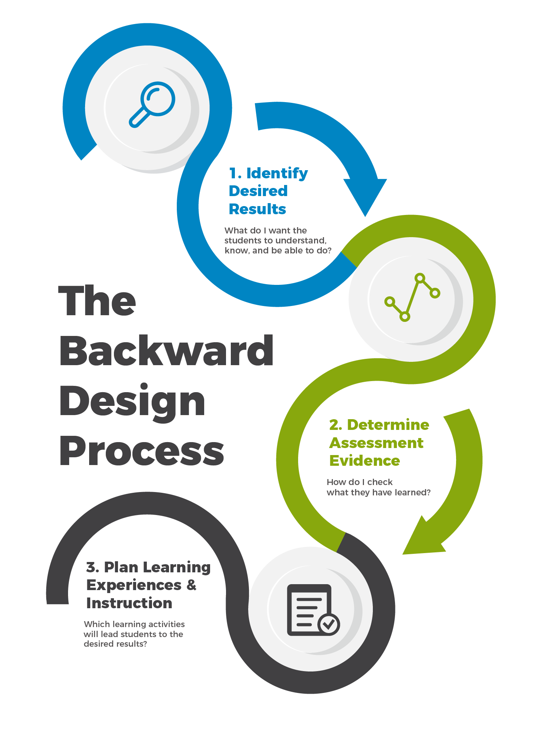

Slide 5
Stage 1: Identify Desired Results
The first stage in the design process calls for clarity about instructional priorities. What are the essential standards?
What do we want students to be able to do with their learning in the long run?
What should students come to understand in order for them to transfer their learning?
What essential questions will students explore?
What knowledge and skills will students need to acquire?

Slide 6
What is the essential standard?
4.NBT.B.6 Find whole-number quotients and remainders with up to four-digit dividends and one-digit divisors, using strategies based on place value, the properties of operations, and/or the relationships between multiplication and division. Illustrate and explain the calculation by using equations, rectangular arrays, and/or area models.

Slide 7
What will students do?

Slide 8
With What Knowledge or Concept?

Slide 9
Level of Thinking (DOK) & Type of Assessment

Slide 10
Vocabulary

Slide 11
Scaffolds & Supports

Slide 12
Learning Progression

Slide 13
Stage 2: Identify Acceptable Evidence of Learning
The second stage in the design process calls for teachers to determine the evidence needed for learners to demonstrate transfer and understanding as related to the unit goals.
What performances and products will reveal evidence of student understanding and ability to transfer?
What additional assessment evidence will be used to assess other learning outcomes?

Slide 14
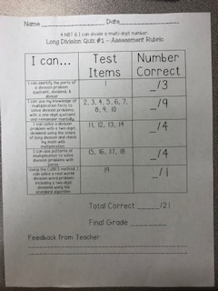
Summative Assessment

Slide 15
Common Formative Assessment #1

Slide 16
Stage 3: Design the Instructional Plan
The third stage in the design process calls for teachers to design experiences for learners to reach and demonstrate attainment of goals.
What activities, experiences, and lessons will lead to achievement of the desired results and success at the assessments?
How will the learning plan help students acquire, make meaning, and transfer?
How will the unit be sequenced and differentiated to optimize achievement for all learners?

Slide 17
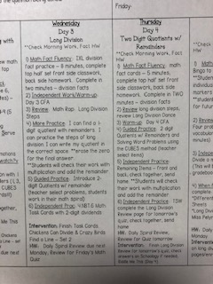
Lesson Plans

Slide 18
Activities & Materials

Slide 19
Activities & Materials

Slide 20
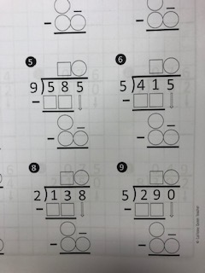
Interventions

Slide 21
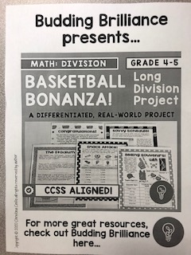
Enrichment

Slide 22
The Six Facets of Understanding
When we truly understand we:
Can explain
Can interpret
Can apply
Have perspective
Display empathy
Have self-knowledge

Slide 23
Recap & Review
Identify your essential standards.
Unwrap each standard for clarity.
Design Formative & Summative Assessment.
Design activities, experiences and/or lessons to meet the rigor of the standard.
Deliver the lessons in a variety of methods.
Check for understanding in multiple ways.
Discuss data with team & reflect.
Design interventions and extensions.

