Slide 1
Data and Accountability Update
Bailey Station Elementary
September, 2019

Slide 2
Indicators
Achievement
  Progress toward On/Track or Mastered
  TN Ready ACH/EOC performance or AMO Targets
  ALL Subgroup/EL, SWD, ED, BHN
Growth (TVAAS)
  Progress toward Approaching, On/Track, or Mastered
  ALL Subgroup/EL, SWD, ED, BHN
Chronically Out of School
  Chronic Absenteeism, Including Out-of-School Suspension
  ALL Subgroup/EL, SWD, ED, BHN
English Language Proficiency Assessment (WIDA)
  Performance on WIDA ACCESS
  % of students meeting growth standards

Slide 3
2019 Achievement
ELA - ALL
Year | # Below | # Approaching | # On Track | # Mastered | % Below | % Approaching | % On Track | % Mastered | % On/Mastered
2019 | 10 | 110 | 184 | 94 | 2.6% | 27.6% | 46.2% | 23.6% | 69.8%
2018 | 7 | 113 | 202 | 78 | 1.7 | 28.3 | 50.5 | 19.5 | 70.0

Slide 4
2019 Achievement
ELA – BHN* Subgroup
Year | Subgroup | # Below | # Approaching | # On Track | # Mastered | % Below | % Approaching | % On Track | % Mastered | % On/Mastered
2019 | BHN | 2 | 29 | 24 | 10 | 3.1% | 44.6% | 36.9% | 15.4% | 52.3%
2018 | BHN | 4 | 32 | 35 | 8 | 5.1 | 40.5 | 44.3 | 10.1 | 54.4
*BHN = Black, Hispanic, Native American

Slide 5
2019 Achievement
ELA – ED* Subgroup
Year | Subgroup | # Below | # Approaching | # On Track | # Mastered | % Below | % Approaching | % On Track | % Mastered | % On/Mastered
2019 | ED | 2 | 3 | 5 | 3 | 15.3 | 23.1 | 38.5 | 23.1 | 54.4
2018 | ED | 0 | 4 | 9 | 0 | 0 | 30.8 | 69.2 | 0 | 69.2
*ED = Economically Disadvantaged

Slide 6
2019 Achievement
ELA – EL* Subgroup
Year | Subgroup | # Below | # Approaching | # On Track | # Mastered | % Below | % Approaching | % On Track | % Mastered | % On/Mastered
2019 | English Learners | 0 | 6 | 4 | 1 | 0 | 54.5 | 36.4 | 9.1 | 45.5%
2018 | English Learners | 1 | 3 | 5 | 0 | 11.1 | 33.3 | 55.6 | 0 | 55.6%
*EL = English Learners

Slide 7
2019 Achievement
ELA – SWD* Subgroup
Year | Subgroup | # Below | # Approaching | # On Track | # Mastered | % Below | % Approaching | % On Track | % Mastered | % On/Mastered
2019 | Students with Disabilities | 6 | 22 | 13 | 3 | 13.7 | 50 | 29.5 | 6.8 | 36.4
2018 | Students with Disabilities | 4 | 17 | 10 | 3 | 11.8 | 50 | 29.4 | 8.8 | 38.2
*SWD = Students with Disabilities

Slide 8
2019 Achievement
Math - ALL
Year | # Below | # Approaching | # On Track | # Mastered | % Below | % Approaching | % On Track | % Mastered | % On/Mastered
2019 | 13 | 80 | 180 | 143 | 3.1 | 19.2 | 43.3 | 34.4 | 77.6
2018 | 17 | 92 | 161 | 130 | 5.7 | 23 | 40.3 | 32.5 | 72.8

Slide 9
2019 Achievement
Math – BHN* Subgroup
Year | Subgroup | # Below | # Approaching | # On Track | # Mastered | % Below | % Approaching | % On Track | % Mastered | % On/Mastered
2019 | BHN | 6 | 24 | 29 | 9 | 8.9 | 35.3 | 42.6 | 13.2 | 55.9
2018 | BHN | 9 | 24 | 25 | 19 | 11.4 | 32.9 | 31.6 | 24.1 | 55.7
*BHN = Black, Hispanic, Native American

Slide 10
2019 Achievement
Math – ED* Subgroup
Year | Subgroup | # Below | # Approaching | # On Track | # Mastered | % Below | % Approaching | % On Track | % Mastered | % On/Mastered
2019 | ED | 1 | 3 | 6 | 4 | 7.1 | 21.4 | 42.9 | 28.6 | 71.4
2018 | ED | 0 | 4 | 6 | 3 | 0 | 30.7 | 46.2 | 23.1 | 69.2
*ED = Economically Disadvantaged

Slide 11
2019 Achievement
Math – EL* Subgroup
Year | Subgroup | # Below | # Approaching | # On Track | # Mastered | % Below | % Approaching | % On Track | % Mastered | %On/Mastered
2019 | English Learners | 0 | 5 | 5 | 1 | 0 | 45.4 | 45.5 | 9.1 | 54.5
2018 | English Learners | 2 | 2 | 2 | 3 | 22.3 | 22.2 | 22.2 | 33.3 | 55.6
*EL = English Learners

Slide 12
2019 Achievement
Math – SWD* Subgroup
Year | Subgroup | # Below | # Approaching | # On Track | # Mastered | % Below | % Approaching | % On Track | % Mastered | % On/Mastered
2019 | Students with Disabilities | 8 | 11 | 22 | 3 | 18.2 | 25 | 50 | 6.8 | 56.8
2018 | Students with Disabilities | 4 | 15 | 12 | 3 | 11.8 | 44.1 | 35.3 | 8.8 | 44.1
*SWD = Students with Disabilities

Slide 13
2019 Achievement
Science - ALL
Year | # Below | # Approaching | # On Track | # Mastered | % Below | % Approaching | % On Track | % Mastered | % On/Mastered
2019**
2018* | 5 | 12 | 72 | 41 | 3.9 | 9.2 | 55.4 | 31.5 | 86.9
*Grade 5 Only
**No scores

Slide 14
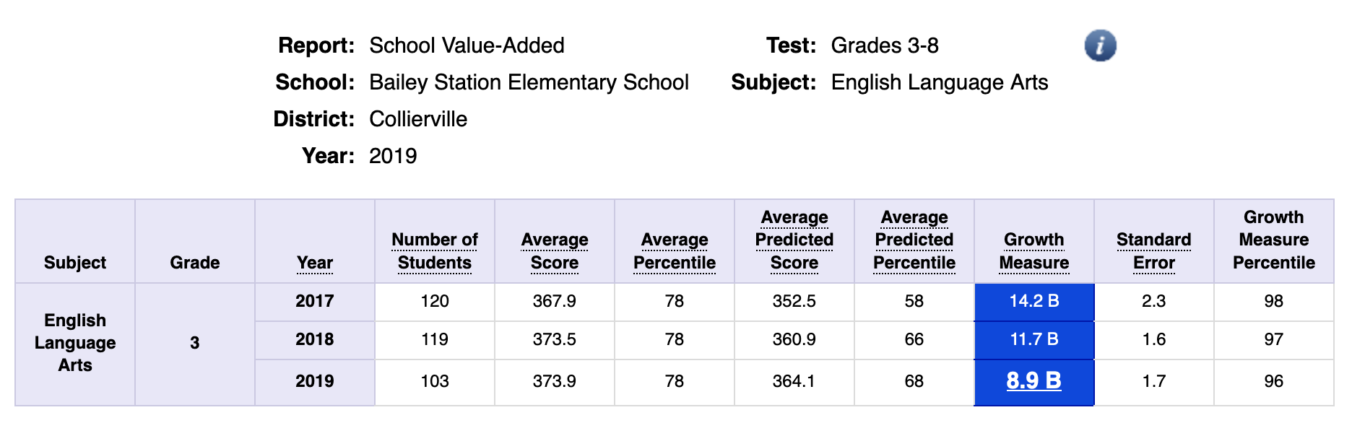
2019 TVAAS – 3rd ELA

Slide 15
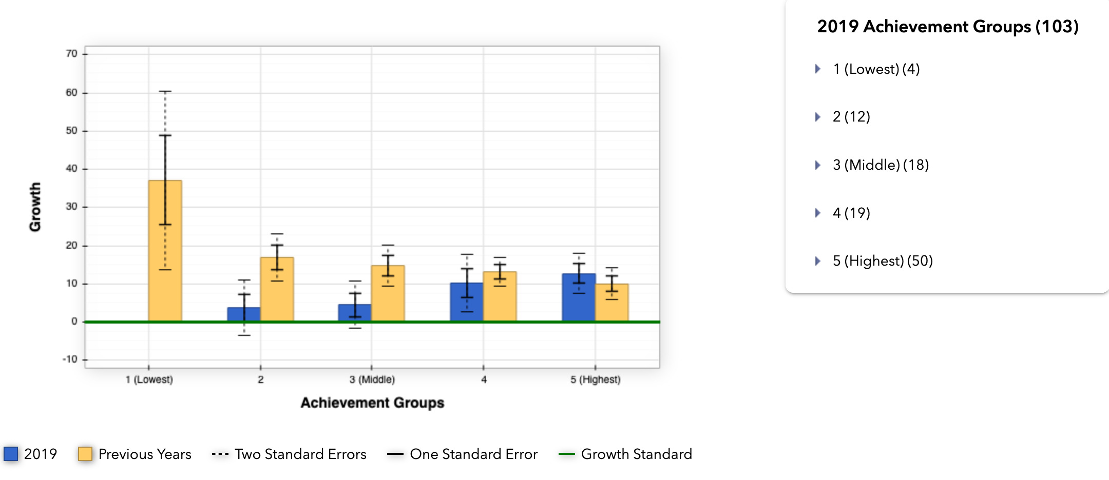
2019 TVAAS – 3rd ELA Quintile

Slide 16
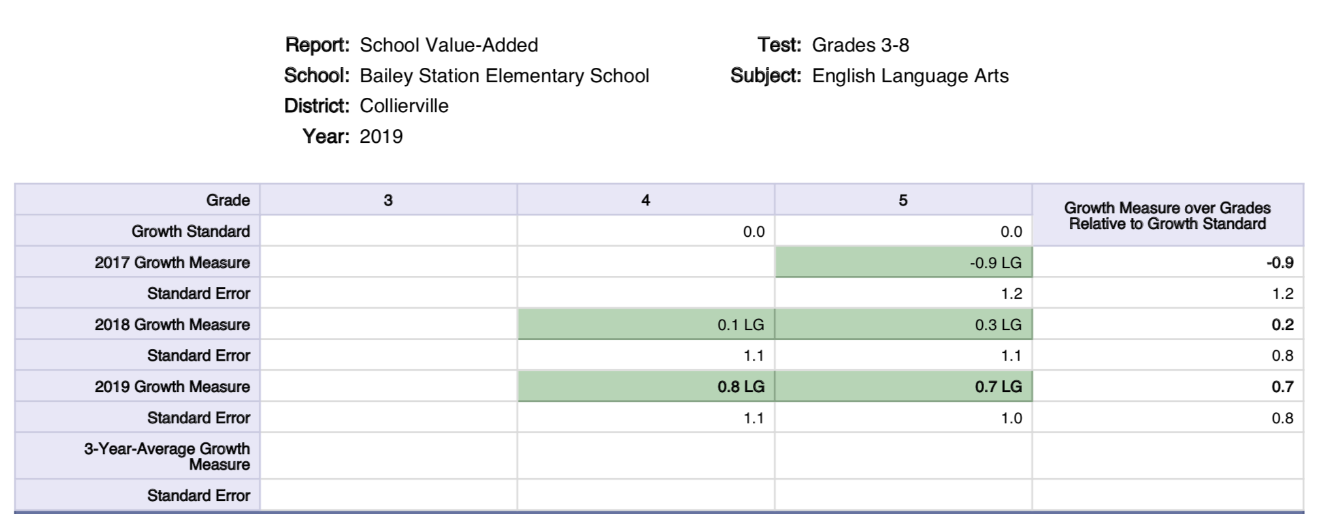
2019 TVAAS – 4th/5th ELA

Slide 17
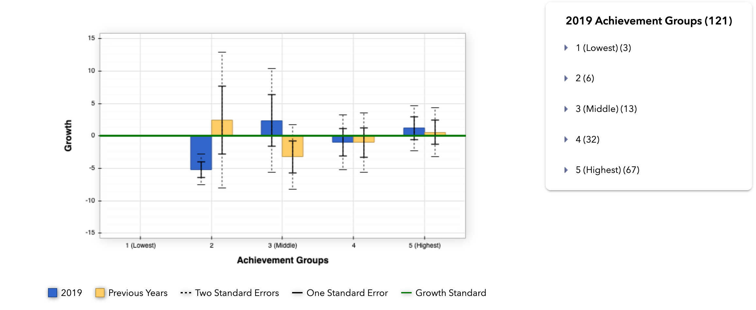
2019 TVAAS – 4th ELA Quintile

Slide 18
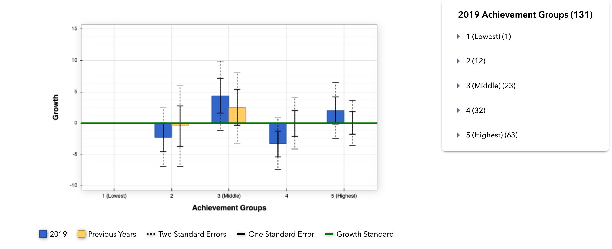
2019 TVAAS – 5th ELA Quintile

Slide 19
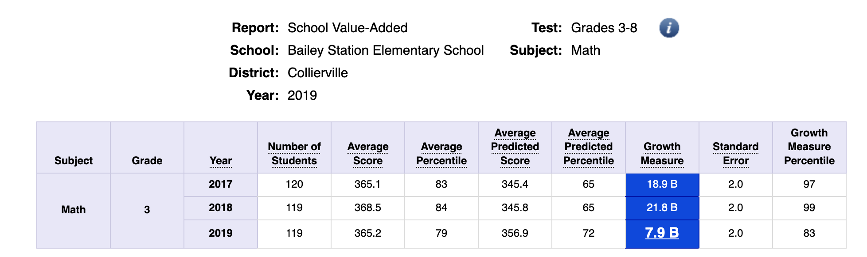
2019 TVAAS – 3rd Math

Slide 20
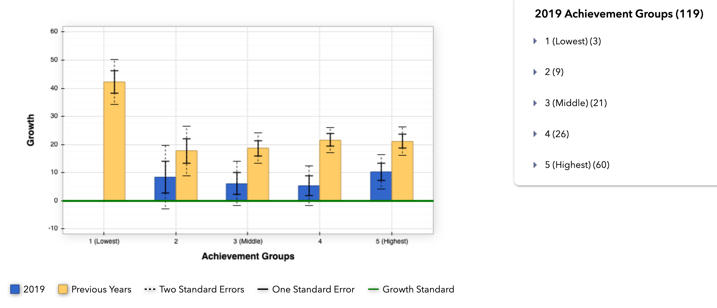
2019 TVAAS– 3rd Math Quintile

Slide 21
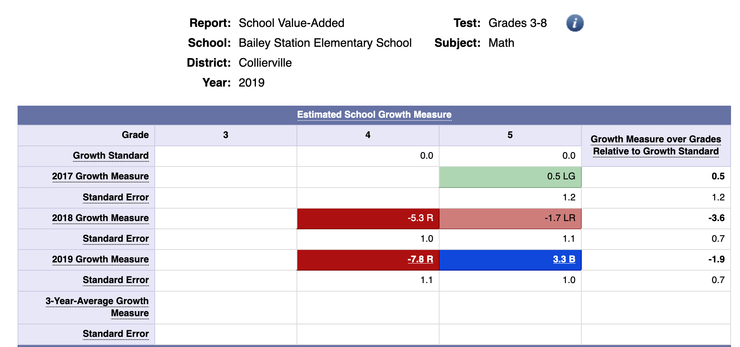
2019 TVAAS – 4th/5th Math

Slide 22
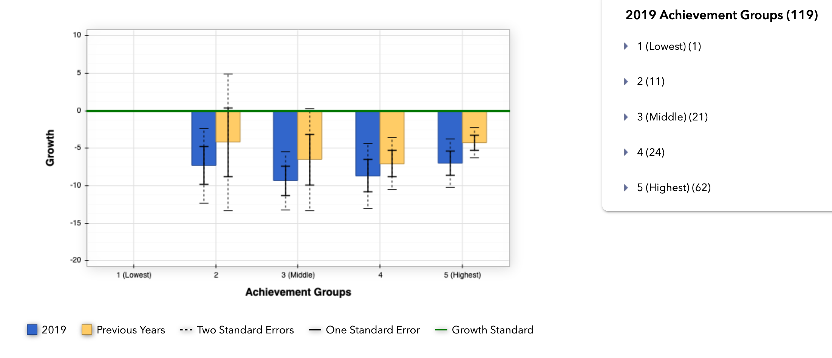
2019 TVAAS– 4th Math Quintile

Slide 23
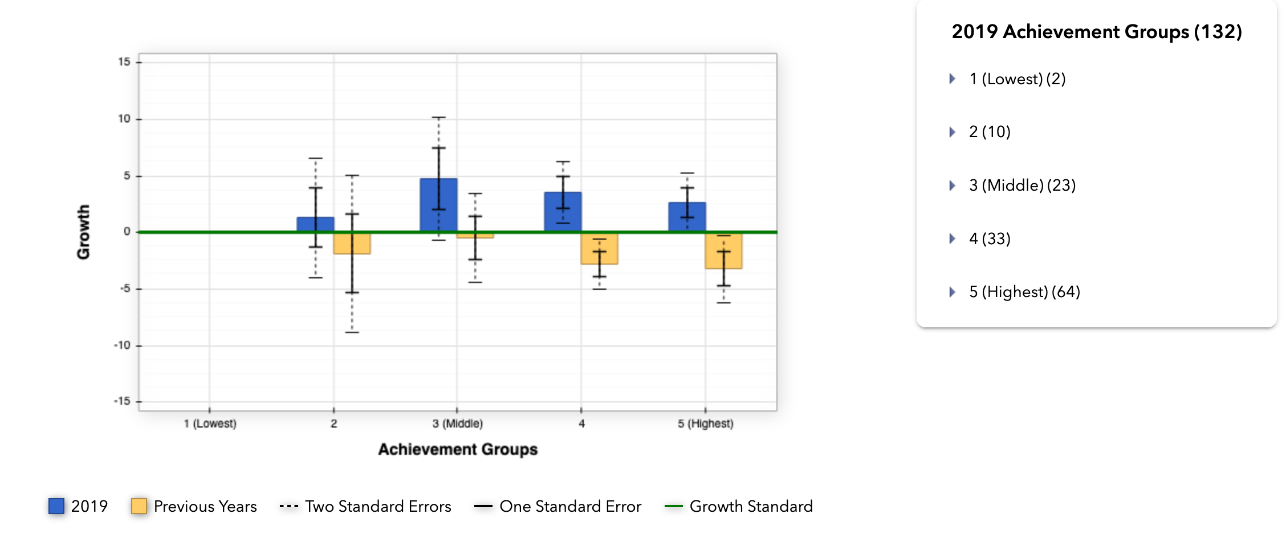
2019 TVAAS– 5th Math Quintile

Slide 24
Chronic Absenteeism
School | Subgroup | Grade | 2018 % Chronically Absent | 2019 % Chronically Absent
Bailey Station Elementary School | All Students | All Grades | 4 | 4
Bailey Station Elementary School | Black/Hispanic/Native American | All Grades | 3.9 | 4
Bailey Station Elementary School | Economically Disadvantaged | All Grades | 3.2
Bailey Station Elementary School | English Learners with Transitional 1-4 | All Grades | 3.7 | 4
Bailey Station Elementary School | Students with Disabilities | All Grades | 2.1 | 4

Slide 25
ELPA – WIDA ACCESS
School | # of Students Available to Exit | # of Students that Exited | % of Students to Exit | # of Students Eligible to Meet the Growth Standard | # of Students that Met Growth Standard | % of Students that Met Growth Standard | Literacy Average | Composite Average
Bailey Station Elementary School | 60 | 31 | 51.7 | 28 | 22 | 78.6 | 4 | 4.3

Slide 26
BSE Overall Score - 3.7
Schools that have an overall accountability score of greater than 3 are designated as Reward schools.
The overall accountability score is based on performance of all students on each indicator (60 percent) and performance of historically underserved student groups on each indicator (40 percent).
Reward schools demonstrate excellence in achievement and growth for all students, as well as all student groups.

Slide 27
Bailey Station – Areas of Strength
  Achievement Math increased by 4.8%
  Chronic Absenteeism
  ELPA Growth: Math ELT 1-4 increased by %21.5%
  English ELT – 1.4 increased by 17.2%
  Math EL w/Trans 1-4 increased 17.2%
  English EL w/Trans 1-4 increased 20%
  Success Rate for All students was a 4 and the only area that was not a 4 was SWD and they were a 3.

Slide 28
Bailey Station – Areas to Strengthen
  Increase growth in ELA and Math for subgroups Black, BHN and SWED.
  Increase school wide growth for Grades 4-5 in the area of Numeracy.
  Increase achievement for on track/mastered in Math and ELA by 2%.

Slide 29
Levels of Effectiveness (LOE)
2019-2019
LOE—classroom observations, growth score, achievement score
LOEs generated in TNCompass
Detailed Guidance for 2018-2019
Level of Overall Effectiveness (LOE) Nullification
Verifying 2018-2019 scores in TNCompass

